Slide 1

CSE Department
Mahaveer Institute of Science & Technology
2024-2025
A MINI PROJECT PRESENTATION
ON
SIGN LANGUAGE RECOGNITION USING CNN
Under the Guidance of
G.Rajini
Asstistant Professor
BY:
D Neeraja [21E31A0526]
B Sriven [21E31A0512]
MD Aqeeb [21E31A0557]
Project Coordinator
Mr. M. Sreenivas Reddy
Associate Professor
Dr. R. Nakkeeran
M. E,Ph.D.,HOD. CSE Dept

Slide 2
Topics
Abstract
Introduction
Existing system
Proposed system
Software and Hardware Requirements
System modules
System Design
Testing
output screens
Conclusion
References

Slide 3
Abstract
Sign language recognition (SLR) plays a crucial role in bridging the communication gap between the hearing and speech-impaired community and the general population.
This study focuses Convolutional Neural Networks (CNNs).
CNNs, with their powerful feature extraction capabilities, are well-suited for processing visual data such as hand gestures and symbols.
The proposed system utilizes a dataset of sign language gestures captured as images or video frames.
Commonly used tools include Python with libraries like TensorFlow and Protobuff for model development, as well as OpenCV for video processing.

Slide 4
Introduction
Sign Gesture will be an ultimate tool for people with hearing disability to communicate their thoughts as well as a very good interpretation for non sign language user to understand what the latter is saying.
Identification of sign gesture is performed with either of the two methods.
1.Glove based method
-the signer wears a pair of data gloves during the capture of hand movements.
2. Vision based method
-further classified into static and dynamic recognition
-Static deals with the 2dimensional representation of gestures
-dynamic is a real time live capture of the gestures

Slide 5
Existing System
Sign language, as one of the most widely used communication means for hearing-impaired people, is expressed by variations of hand-shapes, body movement, and even facial expression.
This project proposes an effective recognition model to translate sign language into text or speech in order to help the hearing impaired communicate with normal people through sign language.
Disadvantages:
Difficulty with Dynamic Gestures
Environmental Sensitivity

Slide 6
Proposed System
We propose to apply CNNs to extract spatial and temporal features from video stream for Sign Language Recognition (SLR).
CNNs have been applied in video stream classification recently years.
It costs several weeks or months to train a CNNs with million-scale in million videos.
It is still possible to achieve real-time efficiency, with the help of CUDA(Compute Unified Device Architecture) for parallel processing.
We develop a CNNs taking multiple types of data as input.
Advantage:
1) High accuracy
2)High efficiency

Slide 7
Software and Hardware Requiremets
Hardware Requirements:
System : intel core i3
Hard Disk : 500 GB
Ram : 4 GB
Software Requirements:
Operating System : Windows 8
IDE : Visual Studio Code
Software : Python 3.7

Slide 8
System Modules
Data Collection
Data Processing
Segmentation
Feature Extraction
Classification

Slide 9
Data Collection
Data collection is an essential part in this project as our result highly depends on it.
We have therefore created our own dataset of ASL having 2000 images of 10 static alphabet signs.
Out of the 2000 images captured, 1600 images are used for training and the rest for testing.
PNG(Portable Network Graphic) is also good in handling high contrast and detailed image.
The webcam will capture the images in the RGB colour space.

Slide 10
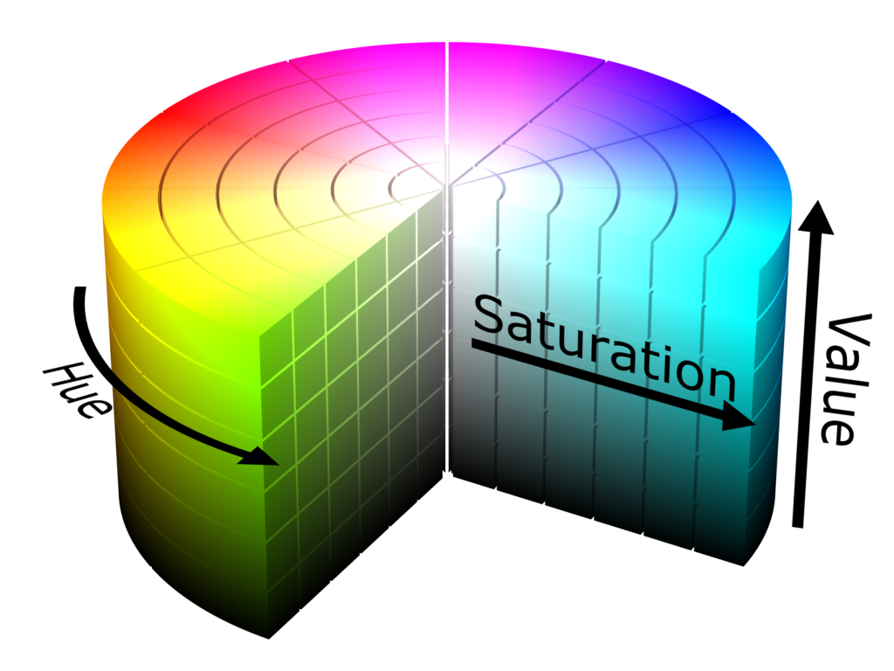
Data Processing
The images obtained are in RGB colour spaces, it becomes more difficult to segment the hand gesture based on the skin colour only.
Transforming the images in HSV colour space.
Hsv is a model which splits the colour of an image into 3
separate parts.
Hue ( angle around the colour cone)
Saturation ( distance around the color cone)
Value ( height around the colour cone)
HSV is a powerful tool to improve stability of the images by setting
apart brightness from the chromaticity.

Slide 11
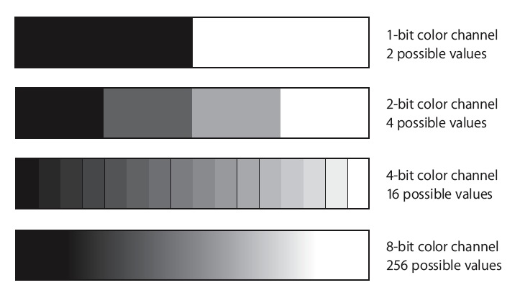
Segmentation
The first image is then transformed to gray scale.
The gray Scale is defined as a spectrum of shades between black and white.
The segmentation process where binary images of size 64 by 64 are obtained where the area in white represents the hand gesture, and the black coloured area is the rest.

Slide 12
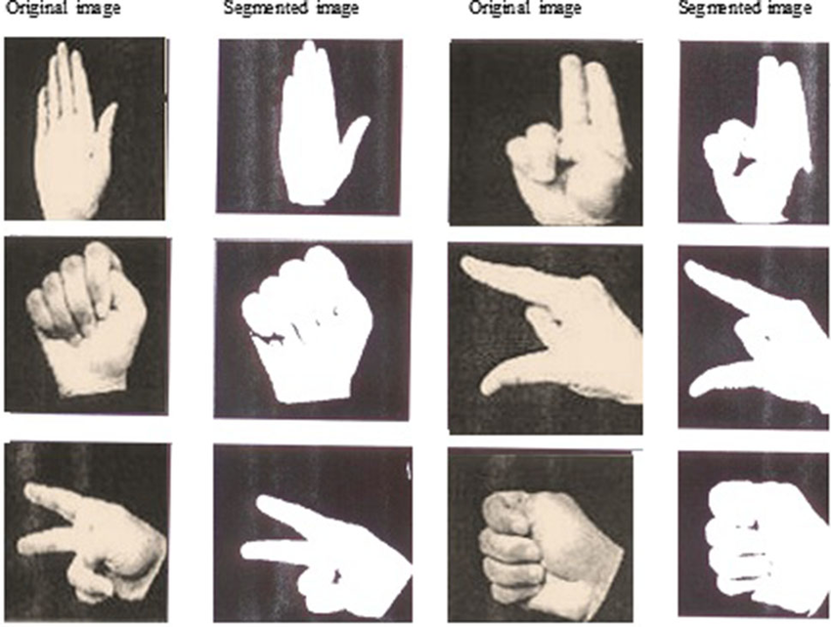
Feature Extraction
One of the most crucial part in image processing is to select and extract important features from an image.
Images when captured and stored as a dataset usually
take up a whole lot of space as they are comprised of
a huge amount of data.
Feature extraction helps us solve this problem by
reducing the data after having extracted the
important features automatically.

Slide 13
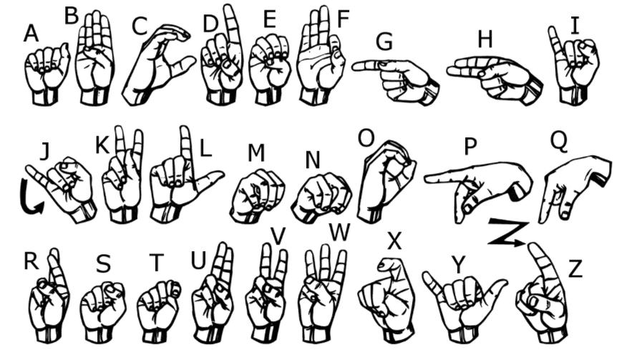
Classification
Classification involves building a model that can interpret images or videos of hand gestures and classify them into corresponding letters, words.

Slide 14
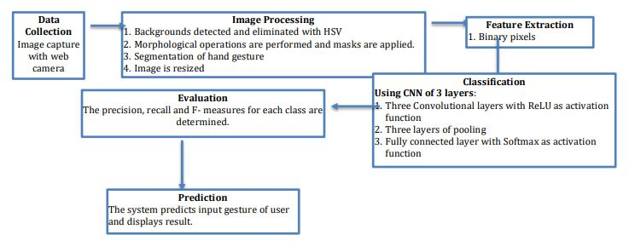
System Design

Slide 15
Use case diagram

Slide 16
Sequence Diagram

Slide 17
Class Diagram

Slide 18
Collaboration Diagram

Slide 19
Testing
1.Unit Testing: Tests individual components.
2.Integration Testing: Ensures combined parts work together.
3.System Testing: Checks the entire system's compliance with requirements.
4.Acceptance Testing: Performed by the end user to confirm their needs are met.
5.Functional testing: Functional tests provide systematic demonstrations that functions tested are available.
6.White Box Testing: It is a testing in which in which the software tester has knowledge of the inner workings.
7.Black Box Testing: It is a testing in which the software under test is treated, asa black box .you cannot "see" into it.

Slide 20
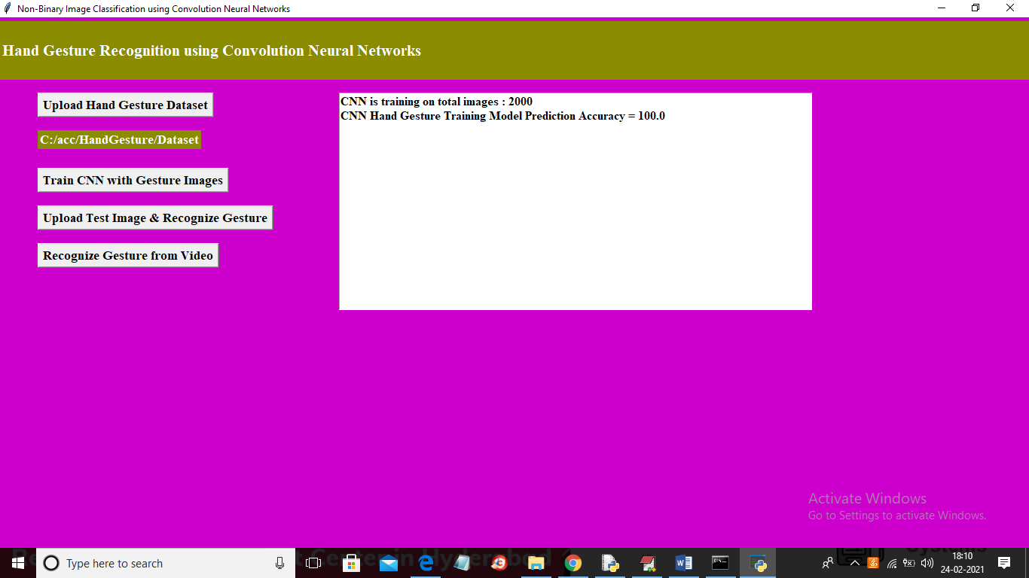
Out screens 1

Slide 21
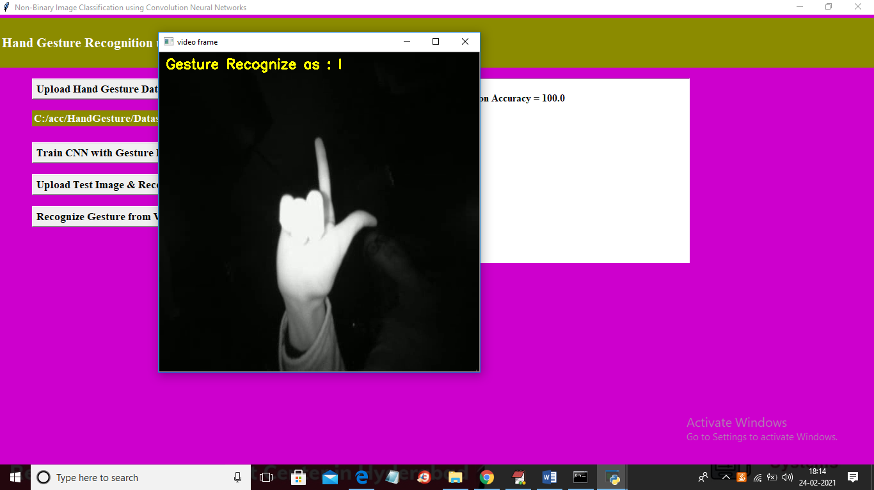
Out screens 2

Slide 22
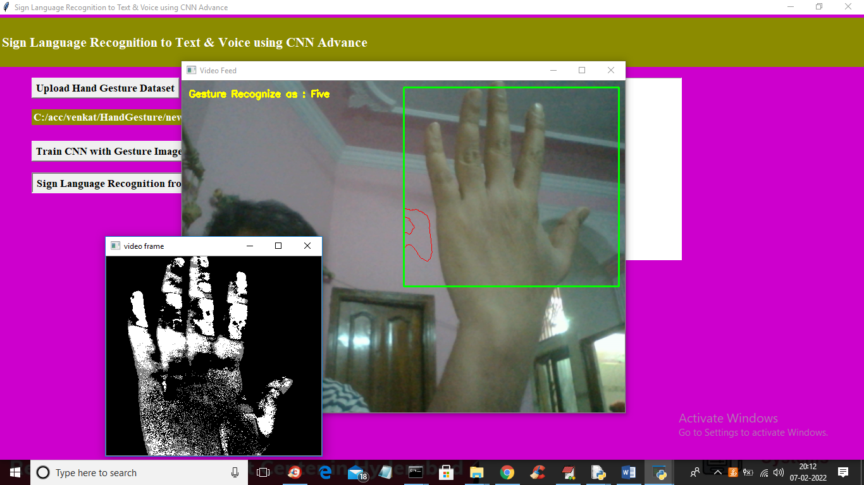
Out screens 3

Slide 23
Conclusion
Sign languages are differ from country to country in terms of gestures, body language and face expressions.
The grammars and structure of a sentence also varies a lot.
Some gestures are difficult to reproduce.
It is hard to keep our hands in exact same position when creating our dataset.

Slide 24
References
[1] https://peda.net/id/08f8c4a8511
[2] K. Bantupalli and Y. Xie, "American Sign Language Recognition using Deep Learning and Computer Vision," 2018 IEEE International Conference on Big Data (Big Data), Seattle, WA, USA, 2018, pp. 4896-4899, doi: 10.1109/BigData.2018.8622141.
[3] CABRERA, MARIA & BOGADO, JUAN & Fermín, Leonardo & Acuña, Raul & RALEV, DIMITAR. (2012). GLOVE-BASED GESTURE RECOGNITION SYSTEM. 10.1142
[4] He, Siming. (2019). Research of a Sign Language Translation System Based on Deep Learning. 392-396. 10.1109/AIAM48774.2019.00083.
[5] International Conference on Trendz in Information Sciences and Computing (TISC). : 30-35, 2012.

Slide 25
Thank You…

